Slide 1
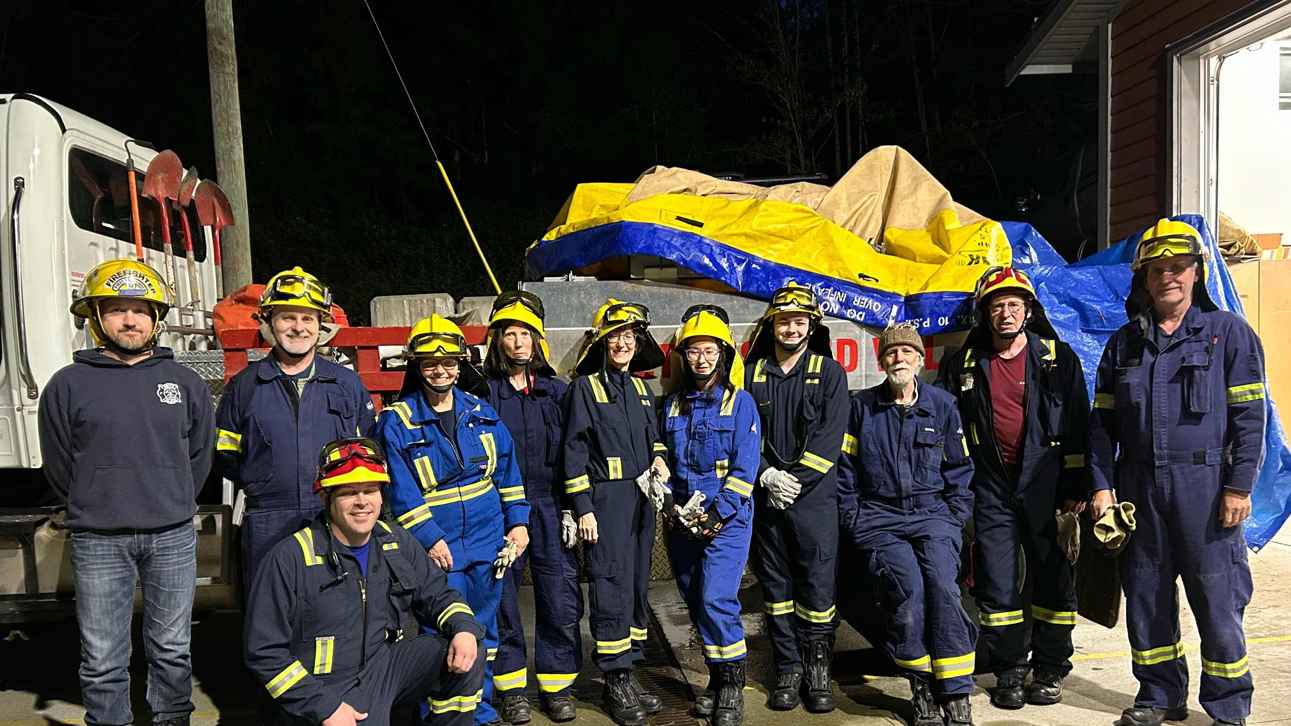
Fire Chief’s Report for 2024
Thetis Island Improvement District AGM May 10, 2025

Slide 2
EMERGENCY RESPONSES 2024
FIRE & MVI 17
HYDRO LINES DOWN 21
MEDICAL ASSIST 71
PUBLIC ASSIST 21
INTER-AGENCY ASSIST 11 (RCMP, Coast Guard)
  TOTAL 141 FIRE DEPARTMENT RESPONSES

Slide 3
1st Quarter: Jan, Feb, Mar 2024
Several severe wind storms & -10° C freezing period
Assist RCMP with 911 hangup, itinerant person investigation
ERT assist for weapons stand-off (6.5 hrs) for medical back-up
Mission Road tanks water system repair
Comox Live Fire Training with 3 members attending
Yellow hats awarded
Aux member Bill Golley certifies as Compressor/SCBA technician
Engine 1 Replacement Committee formed
Caldbeck & Jackman attend 16 hr. Critical Incident Debrief course
Caldbeck re-elected as President of CVFCA

Slide 4
2nd Quarter: Apr, May, Jun 2024
April 1 = start of wildfire season. Equipment prepped & SPU train
Hay fire and vehicle explosion. Many smoke venting complaints
Mission Rd. Water storage system repairs completed
Deputy Chief Peter Luckham announces retirement from TIVFD
Chief & new Deputy Chief Chad Kerr attend FCABC Conference
Eng 1 Replacement team travels to view operational FD vehicles
Annual Pump Test on Engine 1 to keep UL/NFPA certification
Emergency evac & GIS mapping survey
Tim French: Provincial Long Service Medal (30 years)
WSPP-115 SPU training: 2 days, with Ruxton Fire Brigade attending
Telus Fibre Optik installed at Central Hall with assistance by Tim French

Slide 5
3rd Quarter: Jul, Aug, Sep 2024
Unusual public assist for unexploded ordinance
Kids Don’t Float project
Coast Guard assist for sailboat on rocks in Cufra Canal
Other assists include: loose horse, elevator rescue, SPU splash pool, community event traffic control, cabin cruiser aground
55° C reached in attic, alarms inactivated due to extreme heat
SCBA packs (3) purchased through CEPF grant
TIVFFS donations
Hose tests, JPRs and public Extinguisher Clinic
Global Medical Wildfire Skid Unit awarded
Hawaii Mars water bomber fly past in August, circling Thetis Island.

Slide 6
WILDFIRE SEASON APRIL 1 TO OCT. 31
SUMMARY FOR JULY, AUG, SEPT 2024
HIGH hazard July 5, EXTREME July 18, down to HIGH July 29 until Aug 19, MODERATE for one day then LOW for remainder of Wildfire Season
Summary: MODERATE (No Restrictions) 6/92 days; HIGH (Early shift) 25/92; EXTREME (Shutdown) 11/92; LOW (No Restrictions) 50/92 for July, Aug, Sept.

Slide 7
4th Quarter: Oct, Nov, Dec 2024
Many hrs prep for FR instruction, students: + 60 hrs FR course
Serious windstorms and 14 more hydro lines down responses
Appreciation Dinner – Chiefs’ Award to Lt. Norm Kasting
Remembrance Day service and fly over
D/C Kerr & Lt. Kasting attend strenuous START course in Comox
F/C & Lt.Kasting: CBC film podcast re: power out in rural comms.
Mission Rd blocked -trees/lines down, Eng 2 on standby @ Forbes
Backup radio by CVRD to Crofton due to cyclone bomb
Harvest House & Thetis Pantry food drive successful

Slide 8



