Slide 1
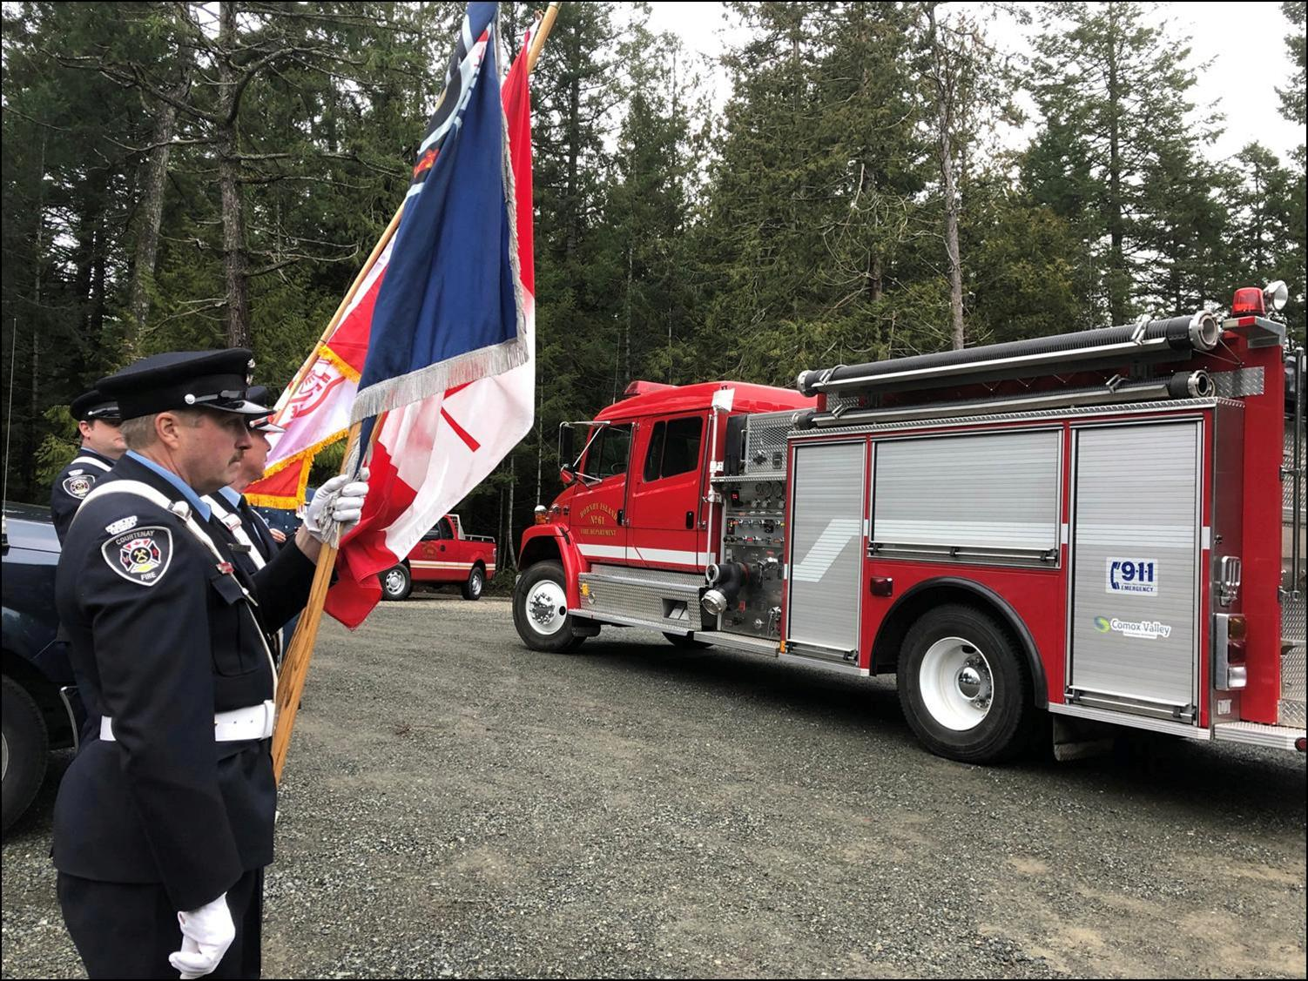
Thetis Island Improvement District
Annual General Meeting
May 10th, 2025
11 AM
Forbes Hall Community Centre

Slide 2
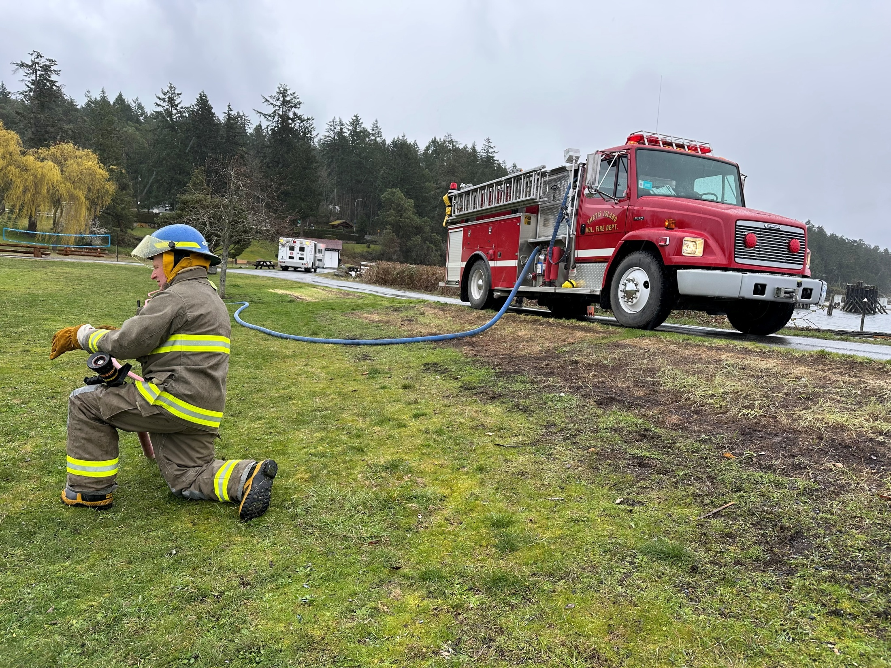
Territorial Acknowledgement
In the spirit of reconciliation, we acknowledge
that this meeting and Forbes Hall Community
Centre is situated on the traditional, ancestral
and unceded territory of the Puneluxutth’
(Penelakut) Tribe and the Lyackson First
Nation.

Slide 3
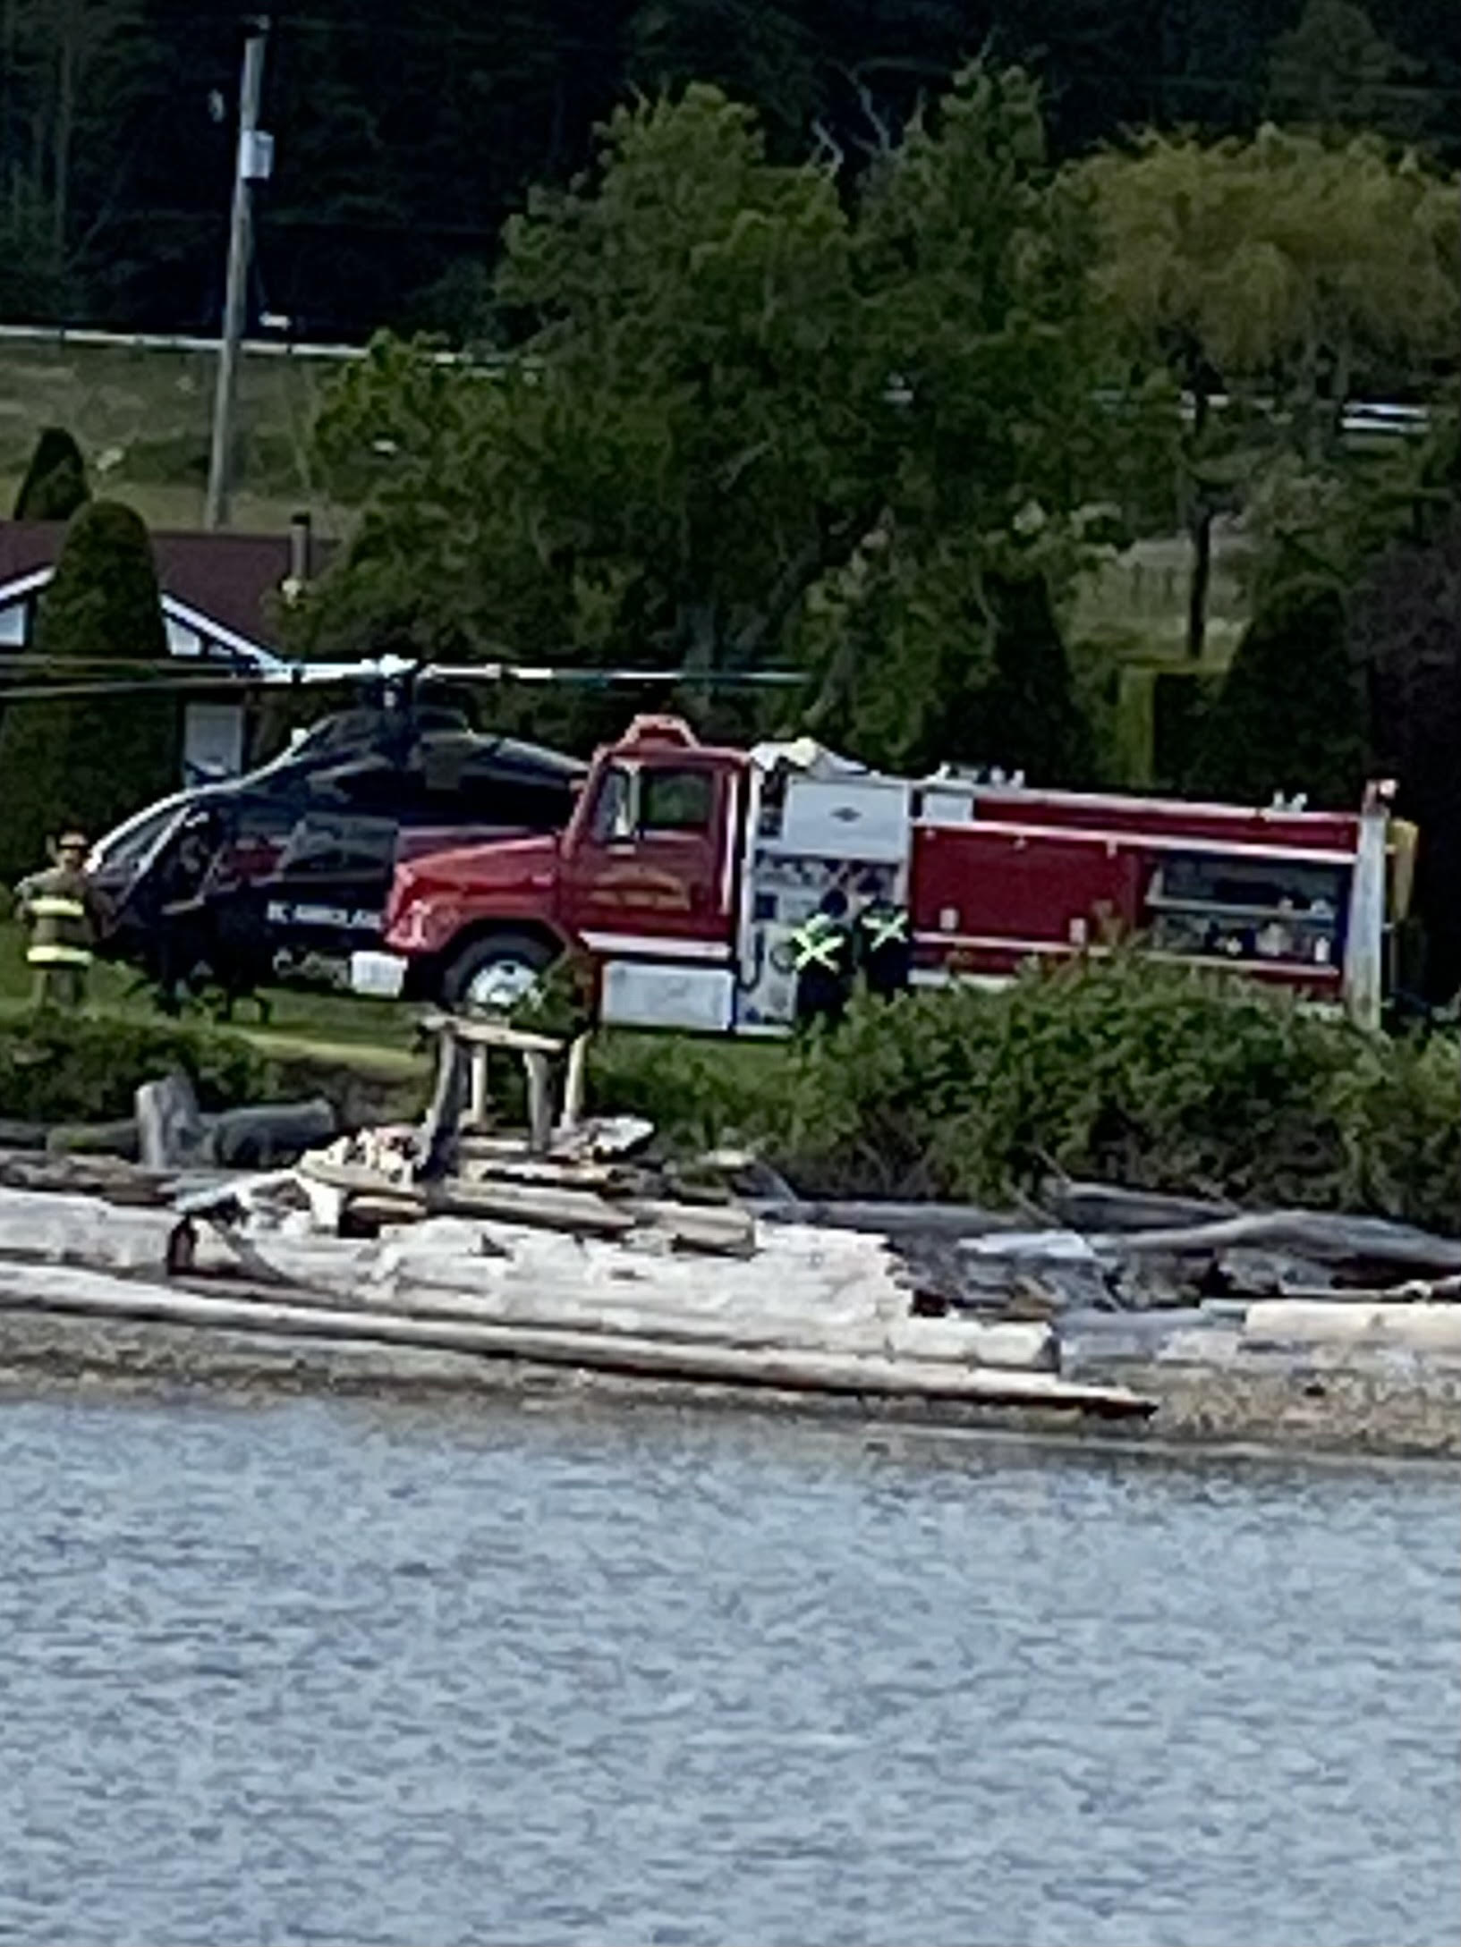
Today’s Agenda
Territorial Acknowledgement
Call to Order, Welcome and Introductions
Approval of May 4, 2024 AGM Minutes
Trustee Remuneration
Audit Report/Approval of Financial Statements
2024 Highlights
Committee Reports
2025 Budget Update
Trustee Election/Acclamation
Fire Department Report
Adjourn

Slide 4
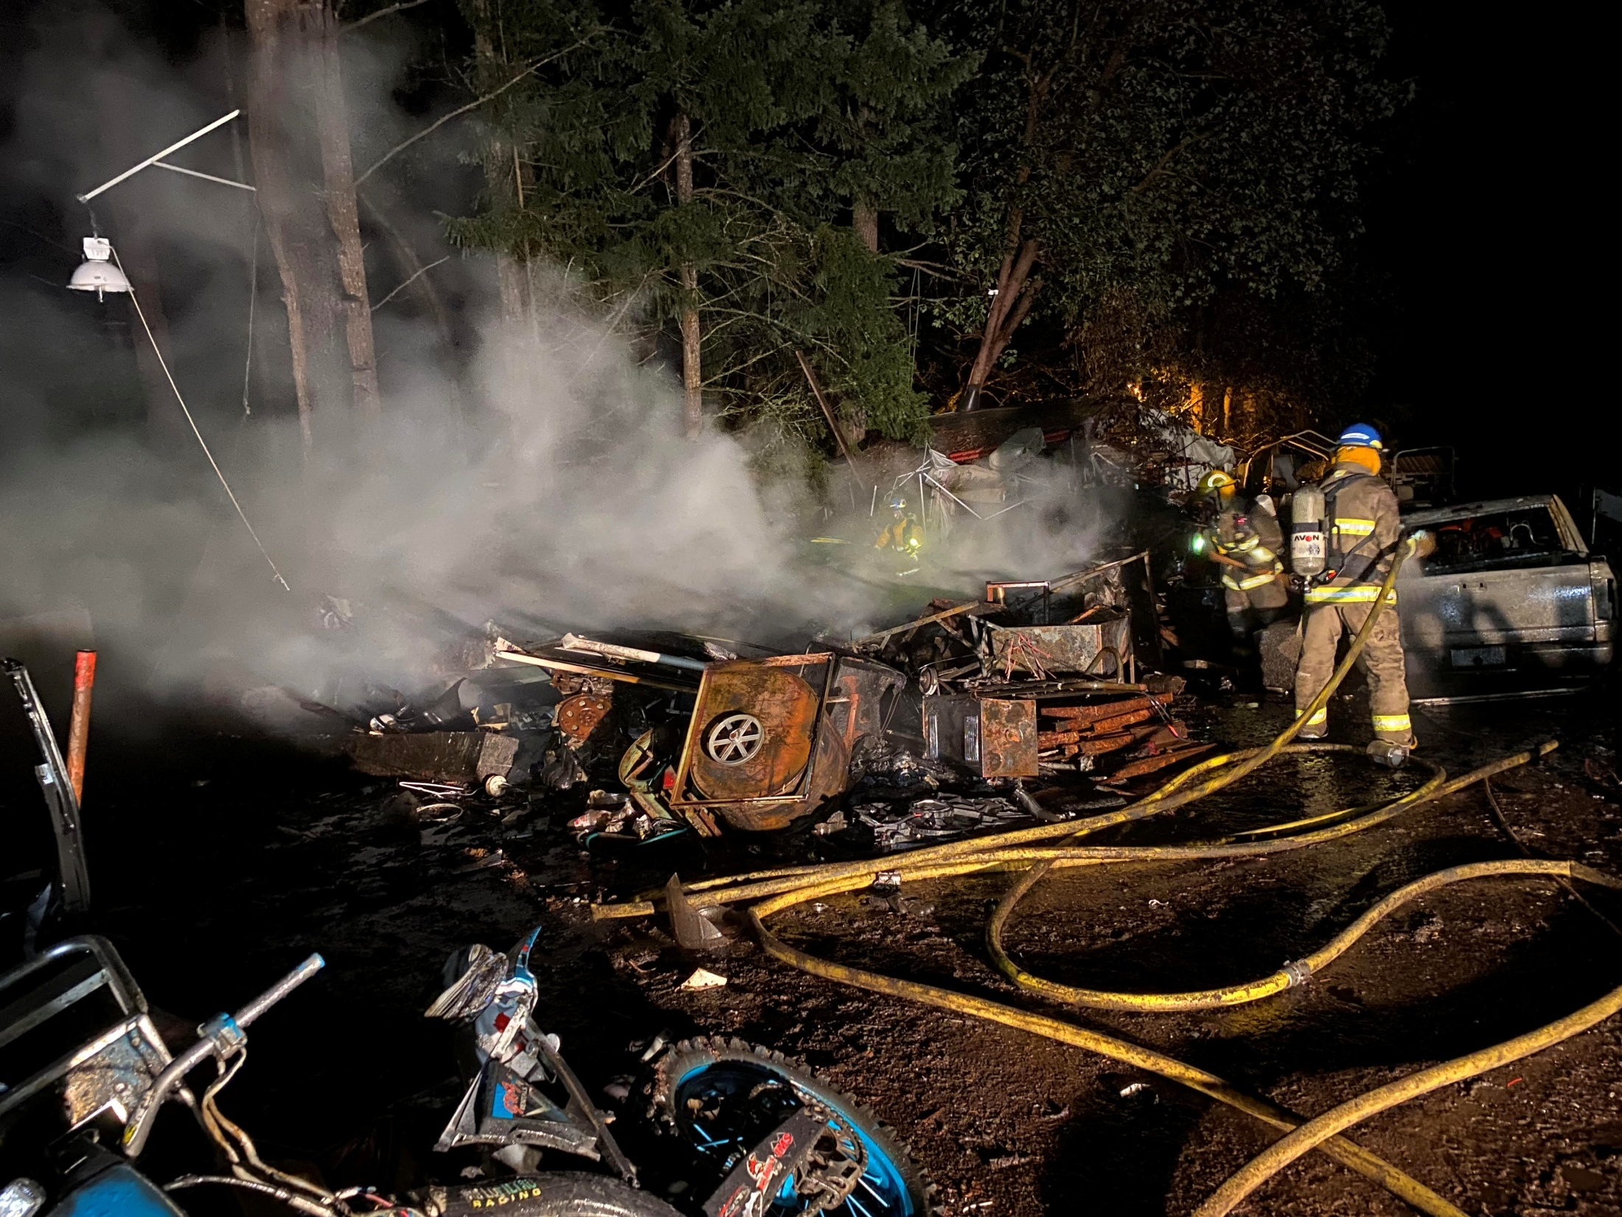
The Role of Trustees
Trustees must make decisions to ensure that adequate funds are available to maintain current operations and to replace capital infrastructure as it ages.
Furthermore, the trustees must establish reserve funds (Capital) and those funds can only be used for the specific purpose for which the fund was established.
Prepare financial statements according to GAAP and appoint an auditor.

Slide 5
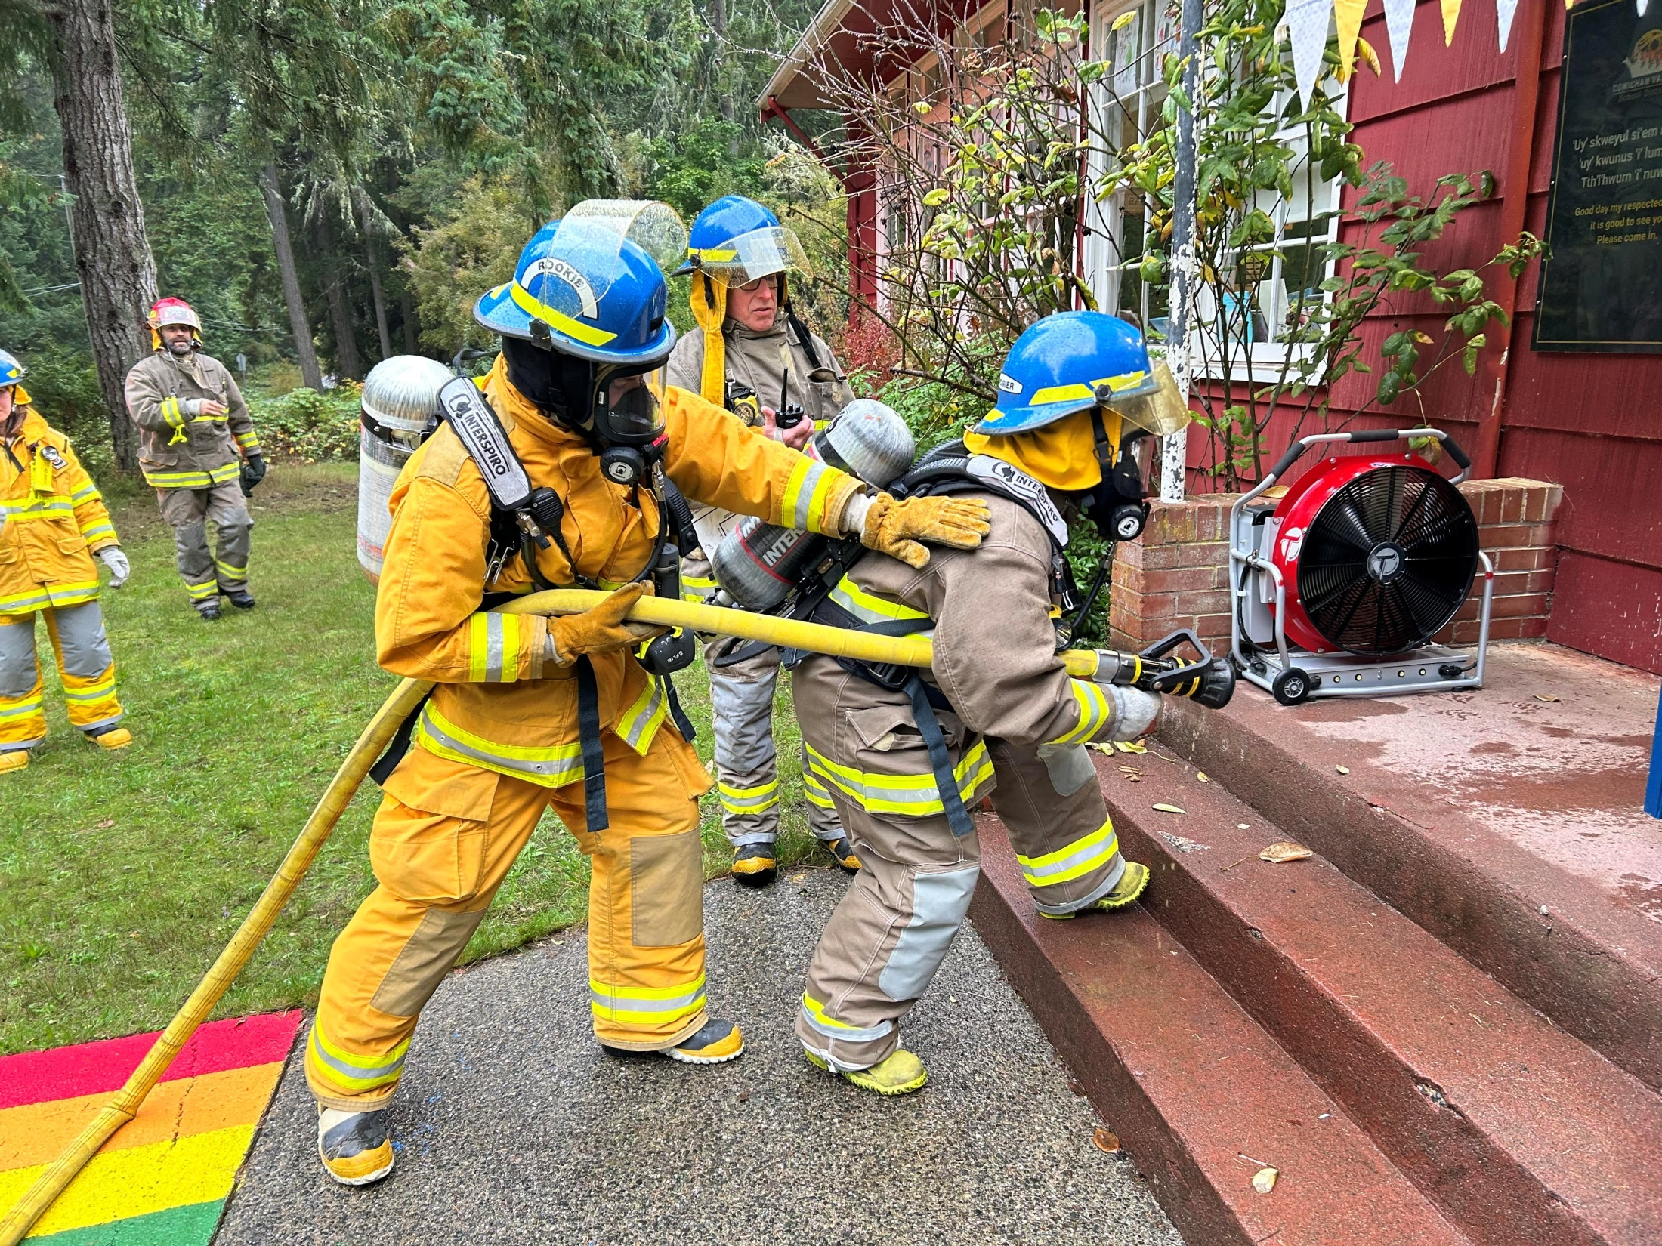
Audit Result
These consolidated financial statements present fairly, in all material respects, the financial position of the Thetis Island Improvement District as at December 31, 2024
And the results of its operations and cash flows for the year then ended
In accordance with Canadian accounting principles generally accepted for British Columbia Municipalities and the Public Sector Accounting Board.
As required by the Municipal Act of British Columbia, we report that, in our opinion, these principles have been applied on a consistent basis.

Slide 6
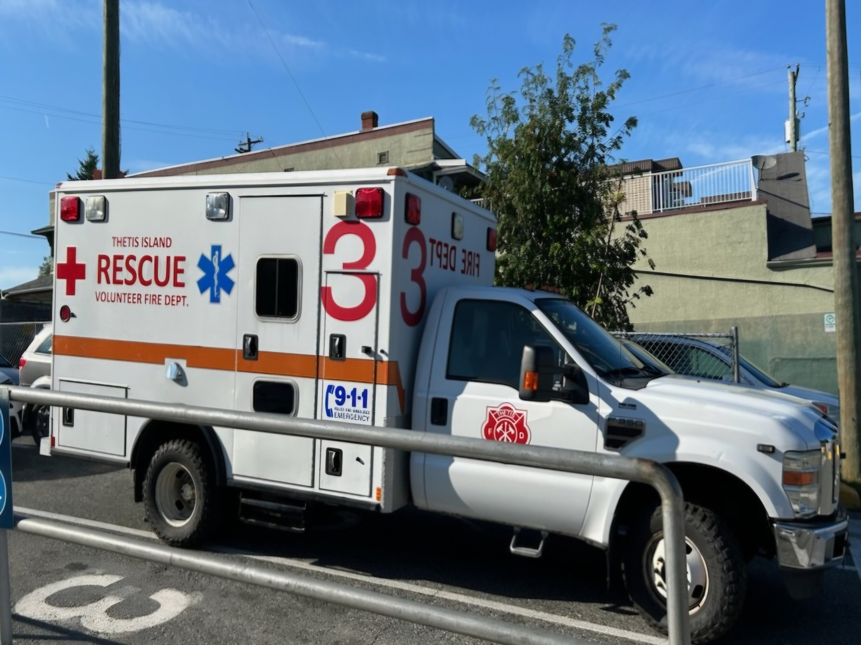
2024 Variance
Budget Actual Variance
M & O 82,350 88,967 (6,617)
TIID 219,700 201,169 18,531
Operating Rev ( 2,875) 12,875
Capital 27,300 47,904 (20,604)
Capital Repl. 54,600 54,600 -
Capital Revenue ( 61,036) 61,036
Isl Health (10,000) (10,000) -
Total 373,950 318,729 55,221

Slide 7
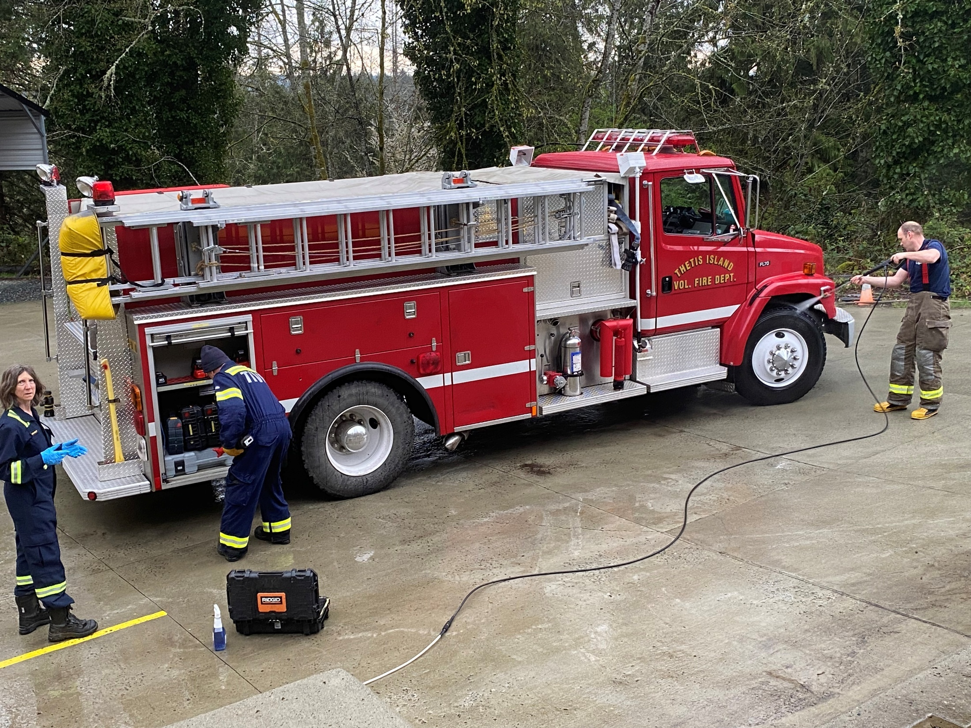
M&O Variance
OVER
Uniforms & Clothing $2020
Vehicle Maintenance 2091
Training – Per Diem 5725
Training - First Responder $1980
Conference & Assoc Dues $2310
Office & Misc Supplies $2144
UNDER Ferry Cost $ 500
Training – Firefighters $9117
Profession Develop & Pub Ed $2495

Slide 8
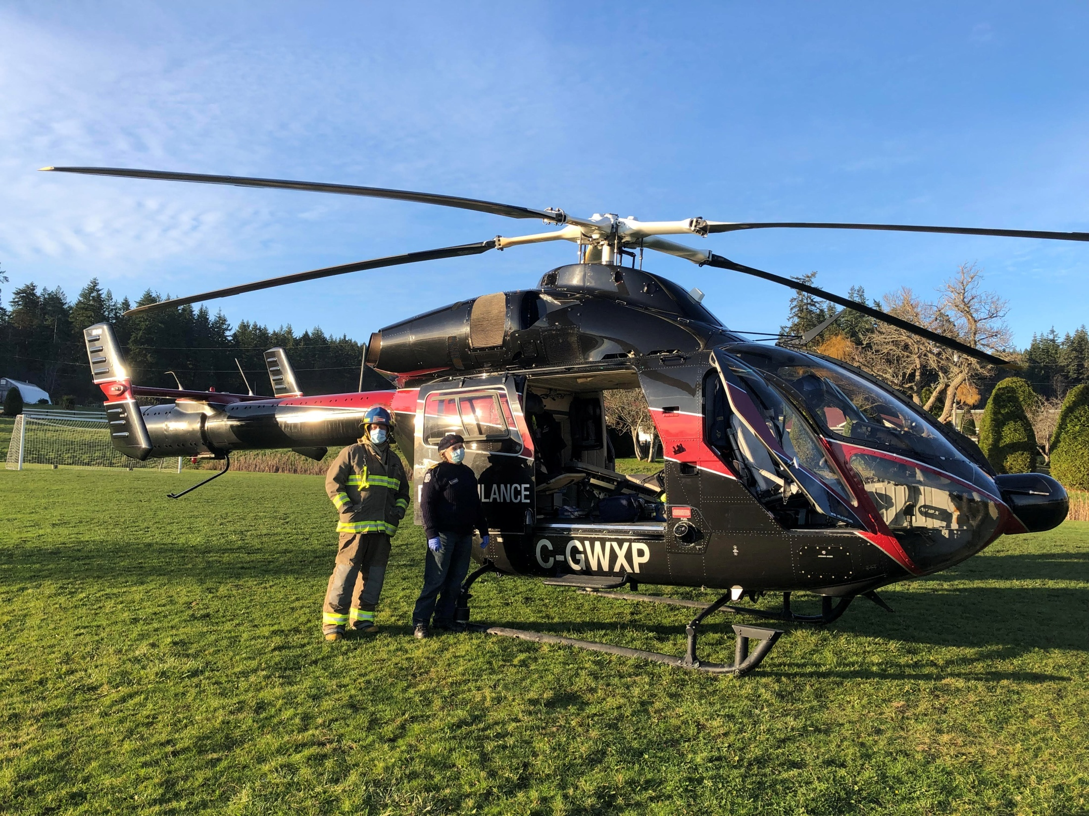
TIID Variance
Over Callout Fuel Expenses $ 832
Office & Misc. Supplies $ 346
Accounting & Legal $1018
Under Insurance – Memb & General $ 853
Insurance – Vehicles $1966
Wages & P/R Taxes $12,591
Training $5385

Slide 9
Capital Projects Variance:
Budget Actual
Revenue:
Cap Repl. 81,900 142,935
Cap Exp 27,300 47,904
Cap Contr. 54,600 54,600
Surplus 40,432

Slide 10

Capital Works Account 2024
Balance December 31st, 2023: $ 421,516.61
2024 Deductions: 2024 Capital Asset Disburse. 47,903.66
2024 Additions: 2024 Interest Earnings 1,980.31
2024UBCM Grant 30,000.00
2024 Bequest 25,000.00
2024 Fund Additions 81,900.00
Balance December 31st, 2024: $ 516,549.20

Slide 11
2024 Highlights
No serious injuries or safety incidents
New fire truck public meeting and purchase agreement. Thanks to the committee.
An extremely generous donation from Pete & Audree Rees; $25,000
Marjan Jackman: Newly certified FR Instructor
Began Airbrake Endorsement for the Fire Fighters
Martin Mars Fly By August 11, 2024

Slide 12
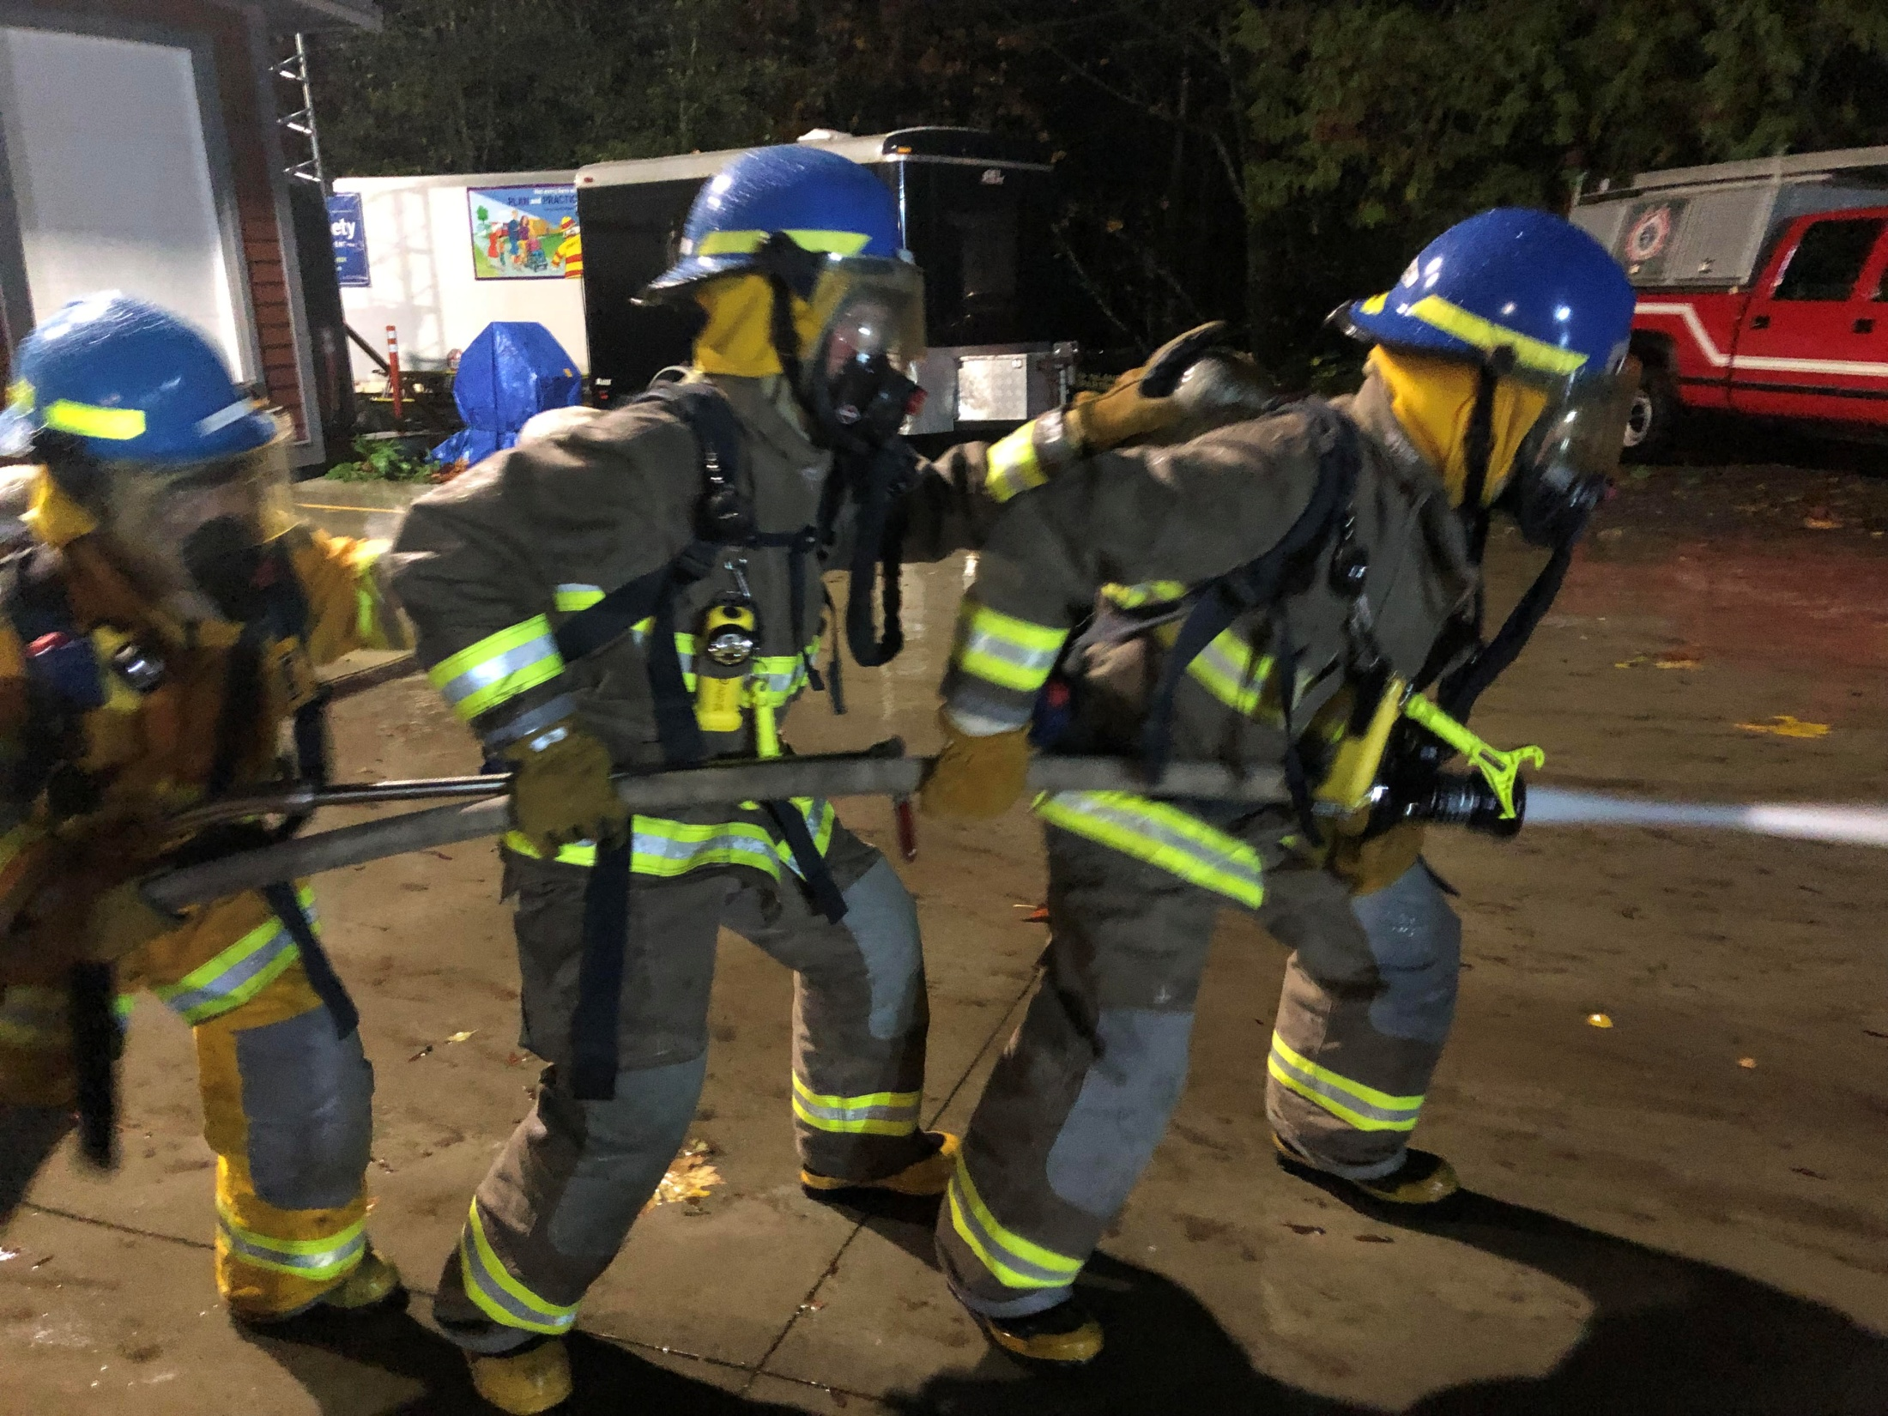
2024 Highlights Con’t
Clean External Financial Audit
Participated in 2 Assembly Meetings
Deputy Chief Kerr replaced DC Luckham
Extraordinary App Dinner and send off for Peter Luckham to the tune of Holding Out for a Hero by Bonnie Tyler
Community Dock work was completed. A few loose ends.

Slide 13
Safety Committee: Bill Dickie
Members: Caldbeck, Dickie, Jackman, Kasting: No serious injuries or near misses
Liaise with Maintenance Committee
Continuing to look at the long term physical and mental health issues
Bill Golley trained in all aspects of SCBA
Kids don’t float program, at the Govy

Slide 14
Building Maintenance: Fred Adair
Upgrade to the Mission Road Tanks following frost damage
Heat exhaust fan installed in the attic - alarm
All external fire pumps were winterized and fire extinguishers certified
Touch up painting in and out, blackberries
Ryder Box humidity control
Hose tower scaffolding…in progress

Slide 15
Community Dock: Michelle Sutter
Repairs to Community Dock have the good-to-go by local experts
Remainder of repairs will be done in the fullness of time
A local, certified and insured welder with their own equipment is needed.
Current funding model is not sufficient for the ongoing maintenance of the Community Dock.
There will possibly be a referendum to cover costs
Suggested cost per household will be in the $25 range

Slide 16
2025 Budget Update (April)
Budget Actual Remaining
M&O 85,050 30,428 54,622
ID 211,967 47,261 164,706
Capital 100,650 80,100 20,550
Contribution 51,300 25,650 25,650
Island Health (10,000) (10,000) 0
Total 438,967 173,439 265,528

Slide 17
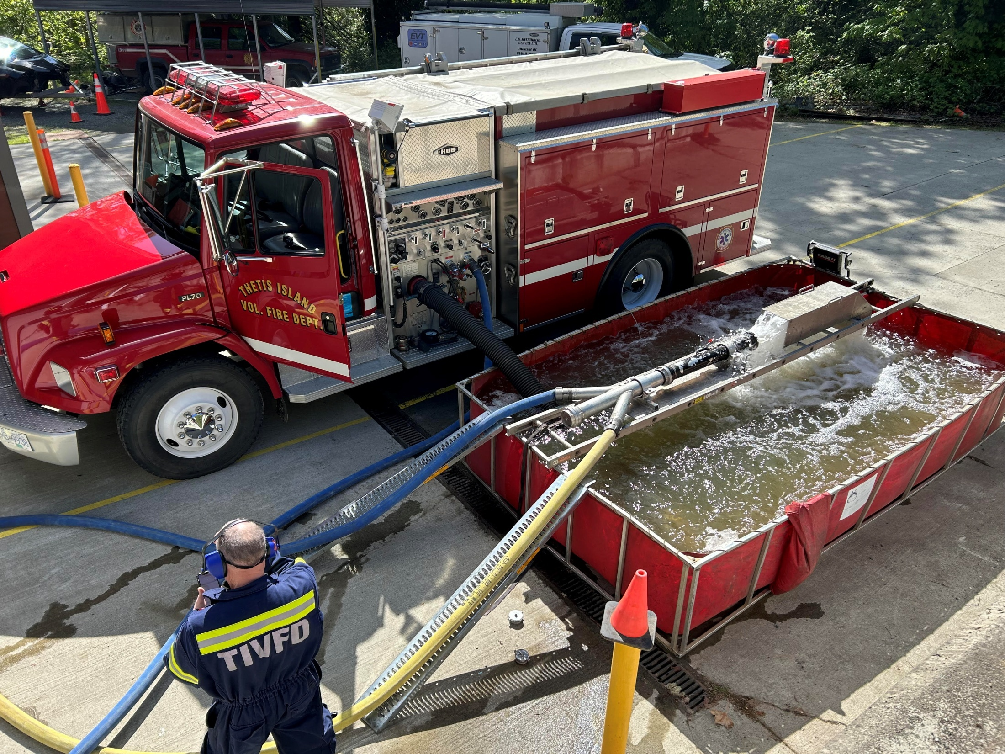
Challenges
Chief Caldbeck 2026 Retirement; Officer Succession
New Engine One manufacturing and tariffs
Tariffs and reciprocal tariffs on FF equipment
New FSA and the erosion of AHJ authority as it applies to our ability to investigate fire causes and inspections of commercial buildings

Slide 18
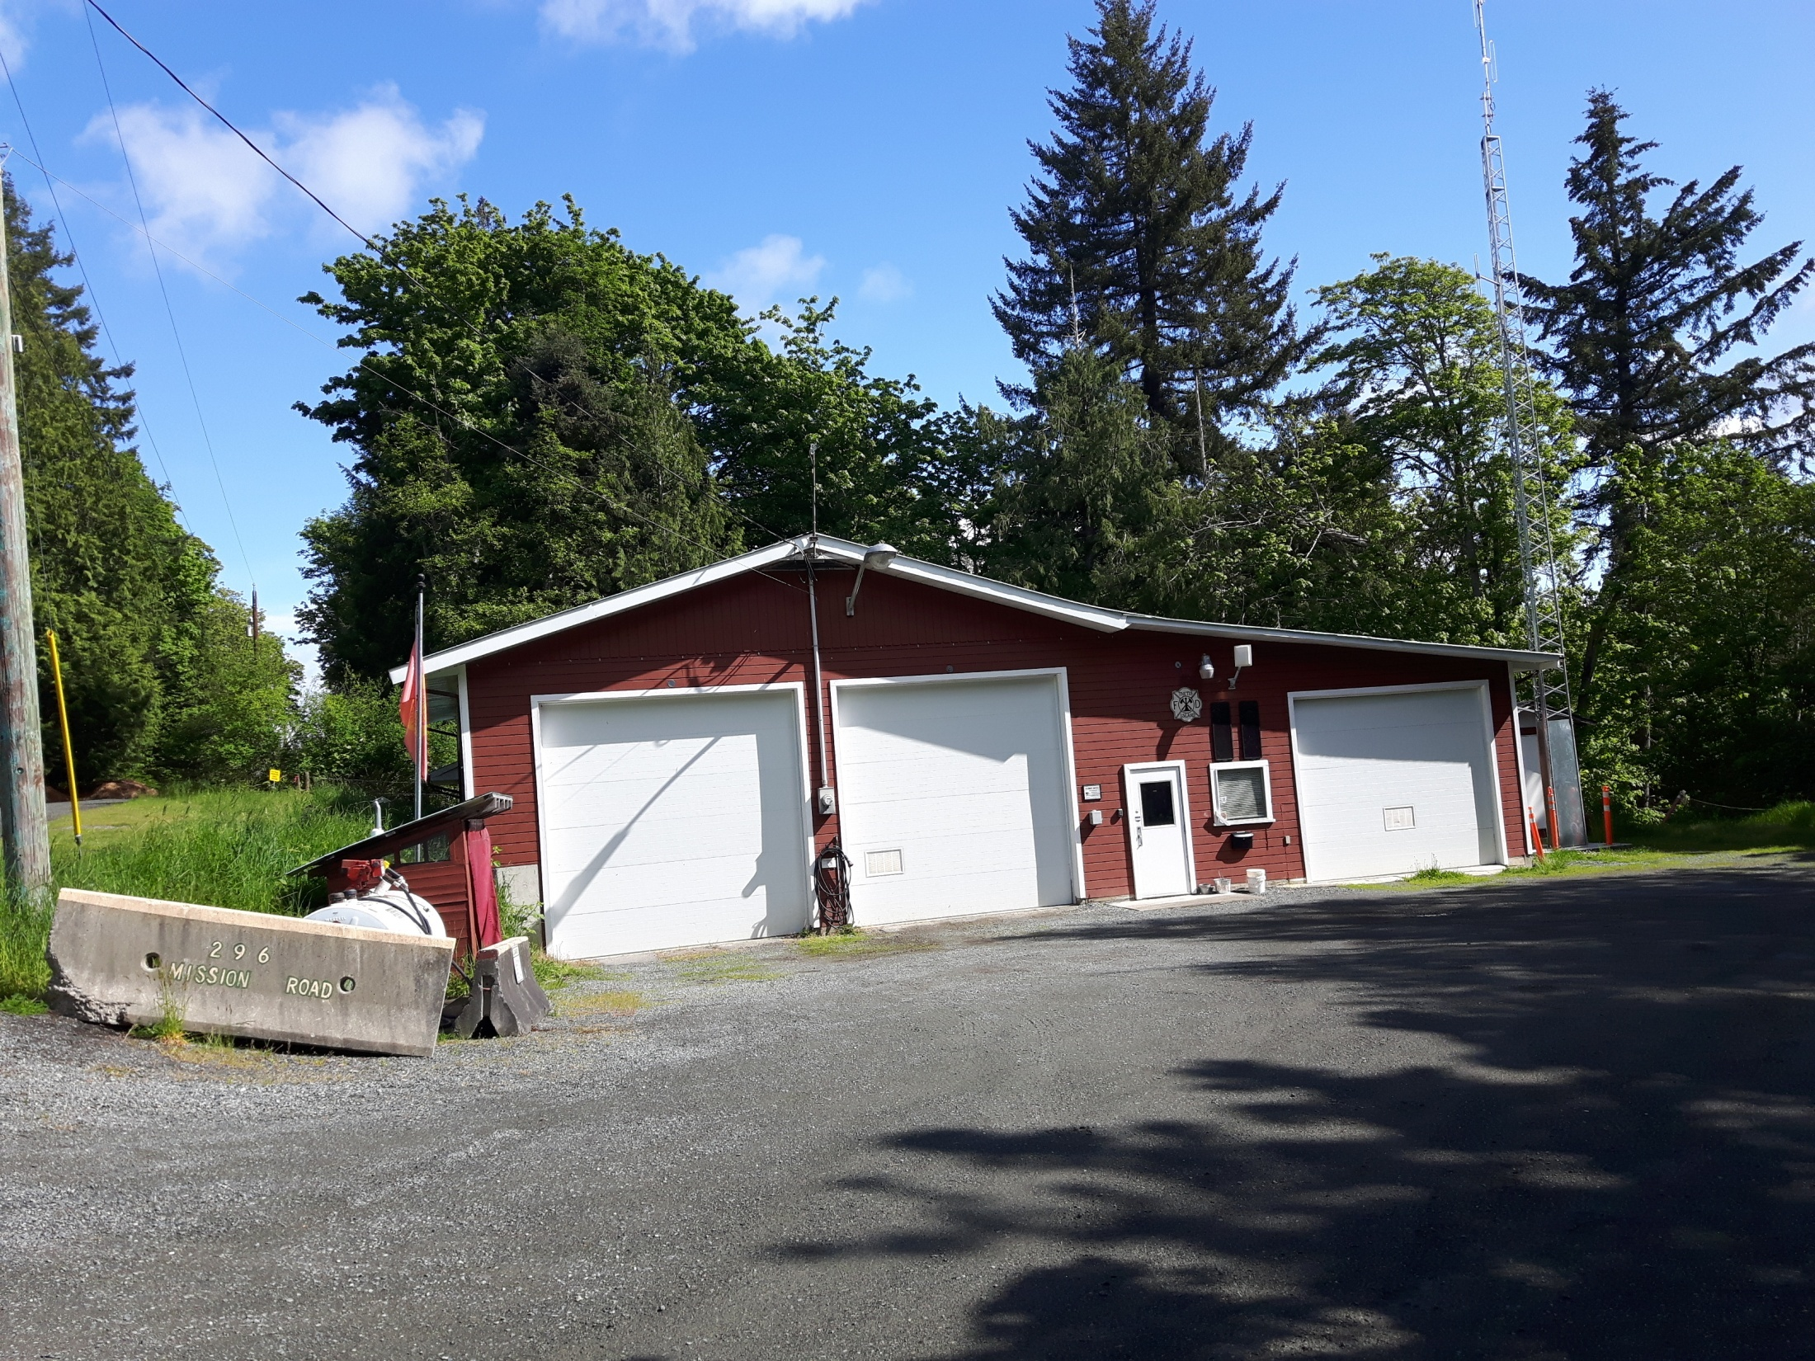
Upcoming:
June 14th; Wildland training; FF comp to the TICA party.
June 22nd; Fire Department Picnic
2026 Budget cycle: Fire Truck purchase; Solar Panel discussion
Continue Airbrake endorsement(s)

Slide 19
Trustee Election
Bill Dickie acclaimed for another term.
Thank you Bill for your continued extraordinary service to the fire department and community.

Slide 20
Fire Department Report
Fire department slideshow and video clips by Fire Chief Jeannine Caldbeck and FF Marjan Jackman

Slide 21
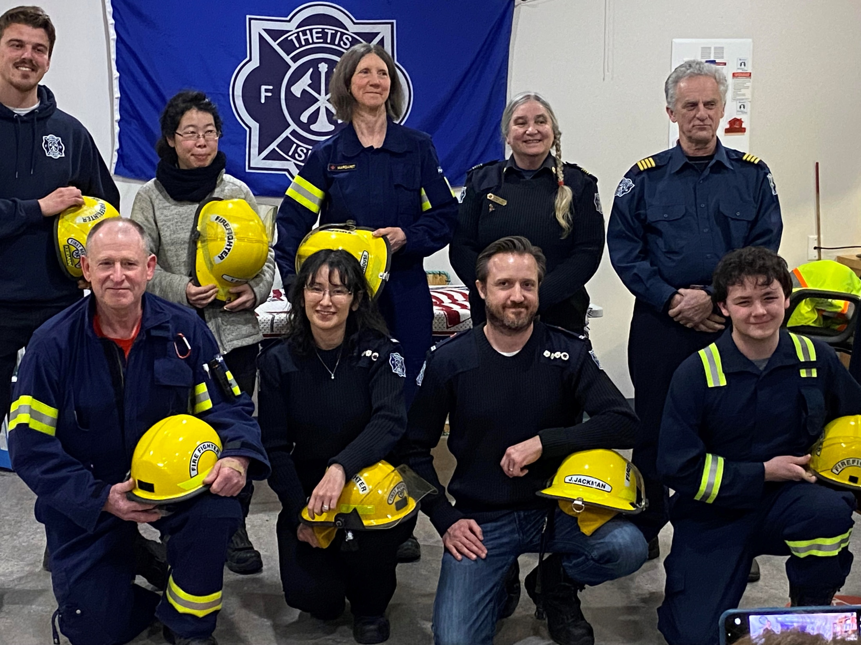
Adjourn
Thank you for coming out and supporting your local volunteer fire department and your local government…

